Slide 1
Airbnb
Sentiment Analysis
In Newyork City
Final Project Jakarta JC-Data Science 0804
By Dicky Alamsyah

Slide 2


1. Intro
Natural Language Processing or NLP is a field of Artificial Intelligence that gives the machines the ability to read, understand and derive meaning from human languages.
Purpose Analyze, structure and find meaning in text and speech.
Challenge Natural language is primarily hard because it is messy. There are few rules.
Real Solution One of the process in the NLP field is Sentiment analysis.

Slide 3
Sentiment Analysis.
The automated process of classifying opinions in a text as positive, negative, or neutral. It works by identifying (and weighting) the subjective information in a set of data, in order to calculate polarity.

Slide 4
Sentiment analysis can be used to classify all sorts of unstructured text, for example, in business, it can be used to like analyze social media interactions and in my case to analyze airbnb reviews.

Slide 5
2. Problem
Sentiment analysis is not a perfect science. Machine, without contextual understanding unable to understand the intent behind the word.
What In my case example, very challenging issue is about sarcasm and using many languages.
Consequence The process to understand the meaning behind each word manually would involve significant time and effort.

Slide 6


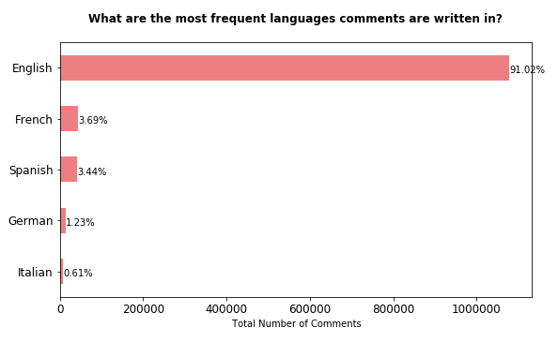
Most of such reviews in Airbnb are written in languages different from English (e.g. French, German, Spanish, Italian), so it is natural that New York, being a European and Asian city very attractive for foreign tourists, has more comments on foreign languages.

Slide 7
3. Goals
Acquire the best model to apply in the business, such as evaluating partners in renting out their place.
Get user opinions based on the reasons written and match them with existing ratings.
Use results of sentiment analysis to design better informed questions to ask on future surveys or maybe rating.
Respond more quickly to signals and shifts from end users.

Slide 8
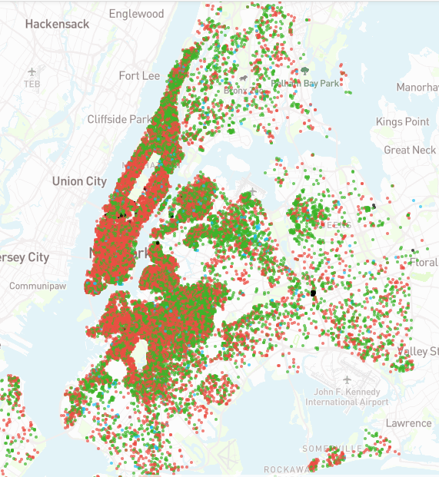
Airbnb reviews dataset provided by the opendata insideairbnb.com resources. The last scraping was in April 2020. And it’s a reliable dataset to be processed for sentiment analysis purpose.

Slide 9
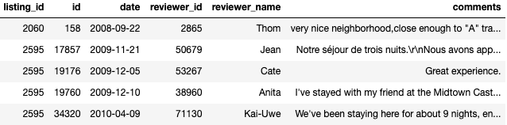
The dataset initially split into listing_id, id, date, reviewer_id, reviewer_name, and comments.
For the first time, because there are no sentiment labels. We use the Rule Based approach with the Lexicon Vader. Next do the analysis and compare it using Classification with Random Forest.

Slide 10
4. EDA
Refer to the Notebook and Dashboard

Slide 11
5. Model
Refer to the Notebook and Dashboard

Slide 12
Vader sentiment analysis is perfect for our model by providing an almost perfect accuracy score. It's just a problem with many languages.
Language detection is not entirely accurate.
The classification model requires more data, the model has good accuracy. But the precision and recall for the "Negative" sentiment needs to be better.
Because the rule based model depends on the lexicon word it also affects the length of sentence in the reviews. It's possible to add more performance if the data is added with a rating like the original Airbnb site.
Shortcoming

Slide 13

Text processing of data using alphabet only, lemmatize with powerful spacy, and remove the accent word.
Compared the effectiveness of Word Embedding (Word2Vec) and TF-IDF on a classification task and ended up with Word2Vec.
The chosen classification model is the Random Forest Classifier with balanced accuracy score of 85% and RMSE 0.45.
Still need more improvement, specially to predicting ‘Negative’ sentiment.
Conclusion

Slide 14
Change all written languages into English by using the translate tools.
Apply further analysis text processing such as POS tagging.
Use Latent Dirichlet Allocation (LDA) to see further the reasons for the context of the review written.
Increase the number of the data used for model processing.
Tuning high-parameter model can improve the performance.
Also changes to the model design with Deep Learning (LSTM or BERT) or vocabulary size could to improve performance
Future Work

Slide 15
Thank You!
Please appreciate by following my github account :)
github.com/dickyalsyah
Feel free to ask further questions to me by email at dickyalsyah@gmail.com

